Slide 1
Dynamic transcription factor activities and networks during restore cellular senescence
2016. 4.28
인하대 MRC
IK-SOON JANG Ph.D.

Slide 2

Contents
Why we are Aging,
Workflow of Various Omics
Potential AMPK activator Nec.B
Omics Analysis in Aged HDF
TF dynamic profile by NLCA in aged HDF
Conclusion

Slide 3


Korea Basic Science Institute (KBSI)

Slide 4
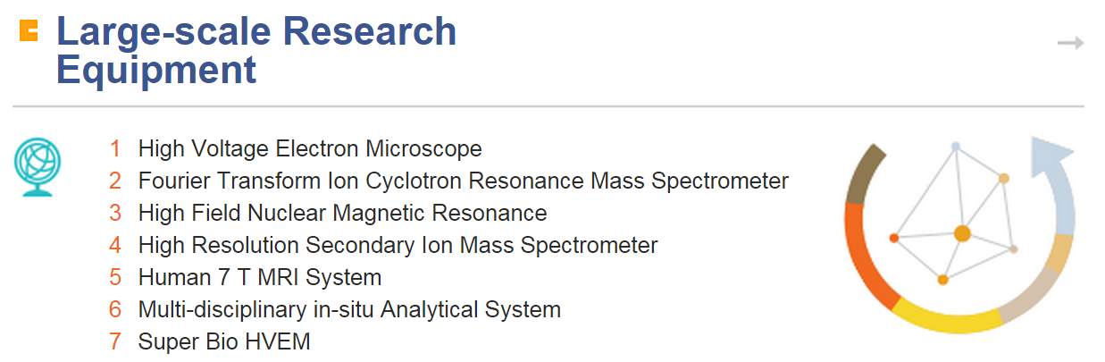
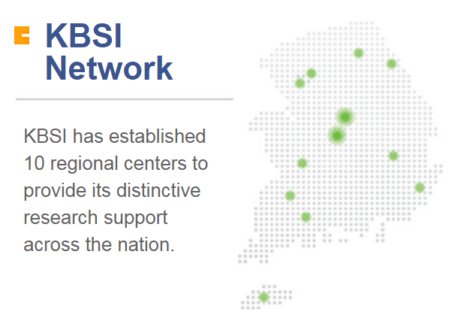
Korea Basic Science Institute (KBSI)

Slide 5
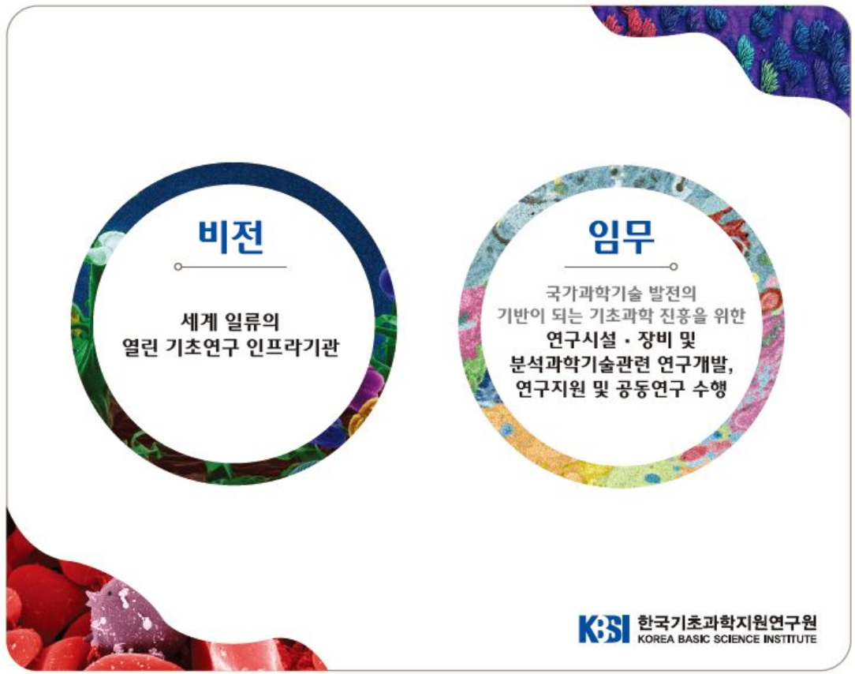
Korea Basic Science Institute (KBSI)

Slide 6





Human shape for Aging

Slide 7
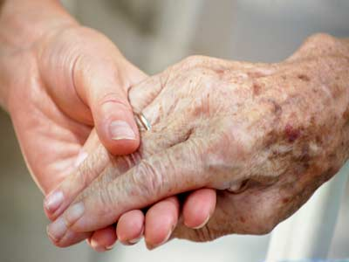
What is Aging? Senescence?
very controversial, but
시간이 경과함에 따라 유해한 변화들이 축적
생체기능이 저하되고 질병에 걸릴 확률이 증가하는 과정.

Slide 8
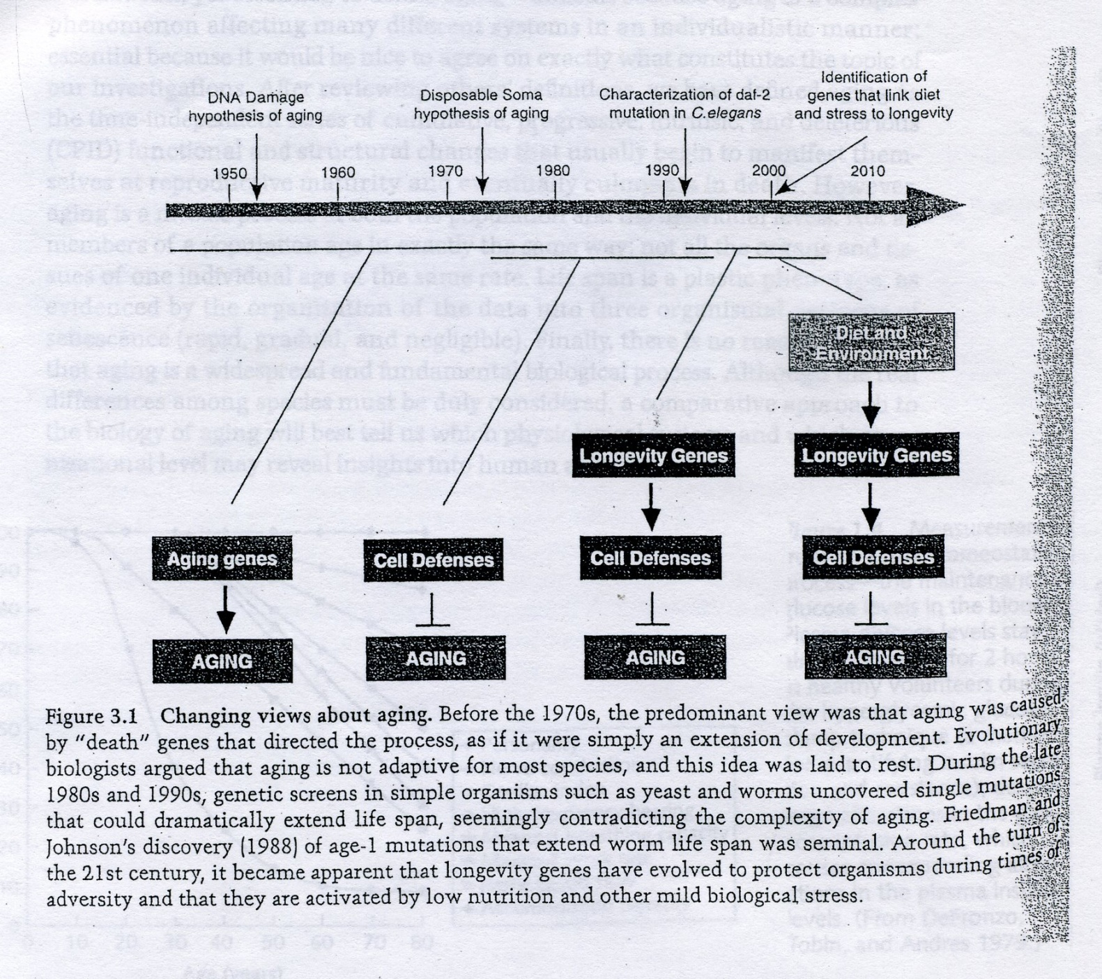
Changeable concept for Aging

Slide 9

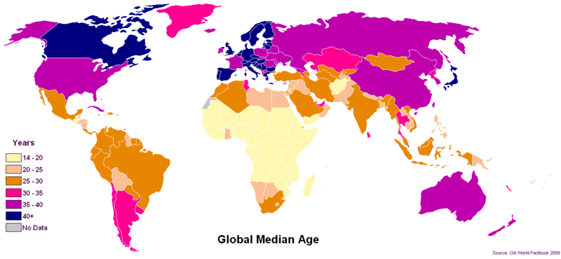
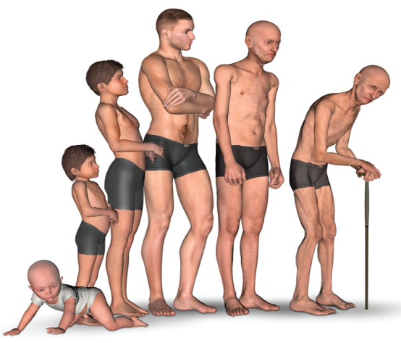
Why we are Aging?
Biological Theories on Aging
Evolutionary theories
Telomere theory
Reproductive-cell cycle theory
DNA damage theory of aging
Autoimmune theory

Slide 10
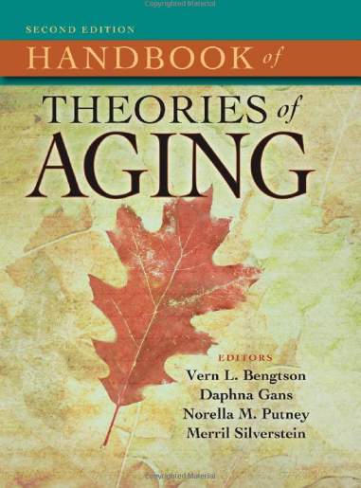
Theories of Aging
Biological Theory
Immunological theory of Aging
Gene action by classical evolutionary theory of aging
Neuroscientific theories of learning, memory, and aging
Programmed aging theories
Free radical and oxidative stress
Psychological theories of Aging
Social context, cognition
Dynamic integration : emotion
Cognitive plasticity
Social Science perspectives
Toward a phenomenology of aging
Life course
Life style …
Etc.

Slide 11
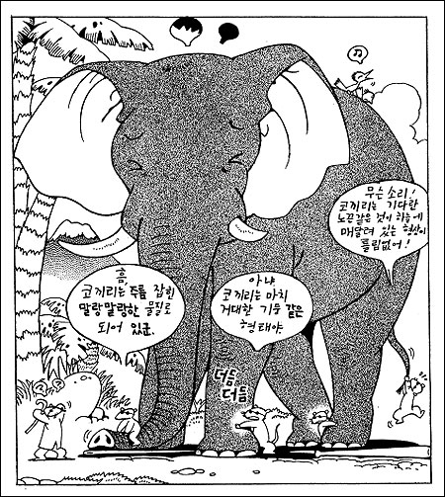
Ageing Study
Gate keeper
ROS
obesity
Caceolin
Cytokines
telomere

Slide 12
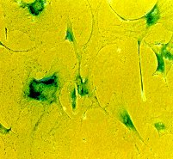
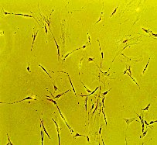
Cellular Senescence
Replicative senescence
Cell numbers
SA-β-galactosidase staining
Morphological changes
No response upon outer stimuli
Increase of ROS
Telomere shortening
Accumulation of DNA mutation
Cell cycle arrest
Passage
“Hayflick limit” 1962

Slide 13
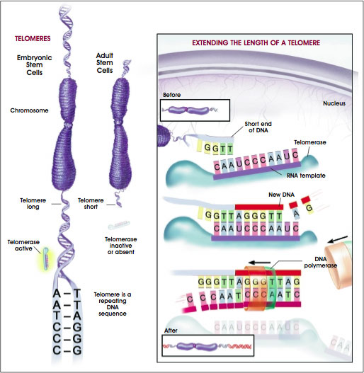
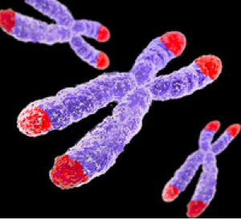

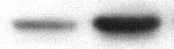
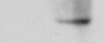
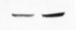
G1 arrest, Telomere
presenesent
senescent
p16^{INK4a}
p21^{Waf-1}
p53
α-tubulin

Slide 14
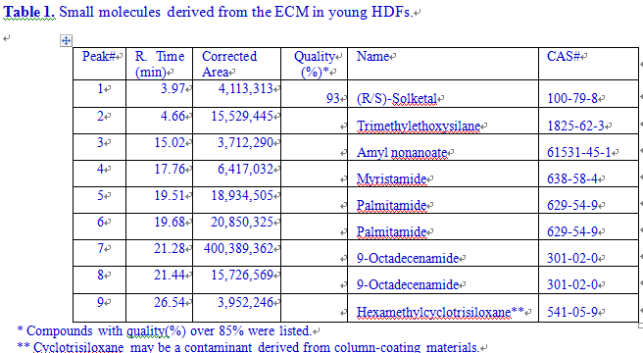
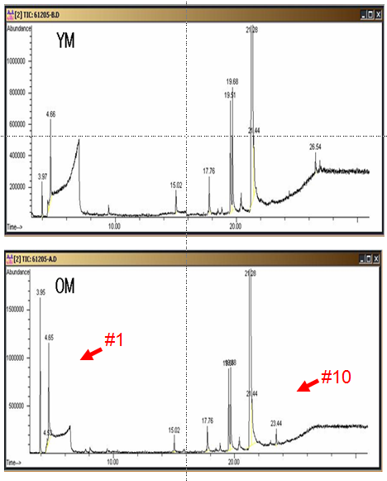
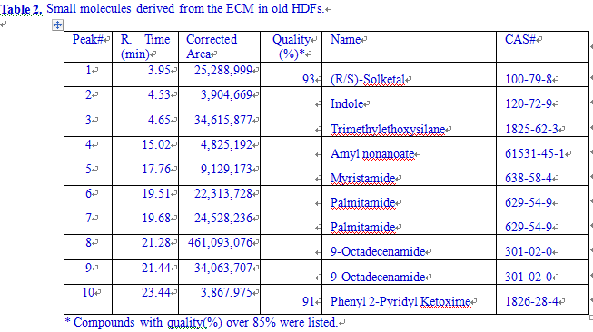
Phenyl 2-pyridyl ketoxime induces cellular senescence-like alterations
via NO production in human diploid fibroblasts. Aging Cell

Slide 15
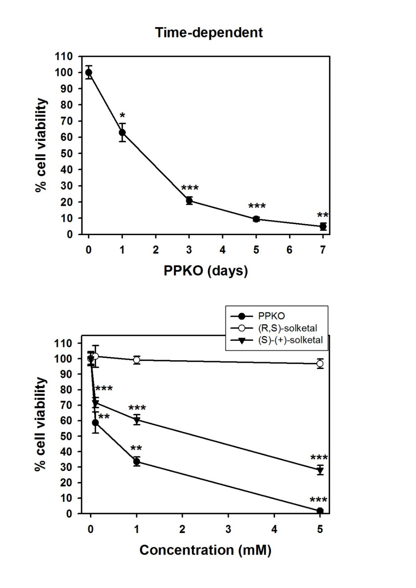
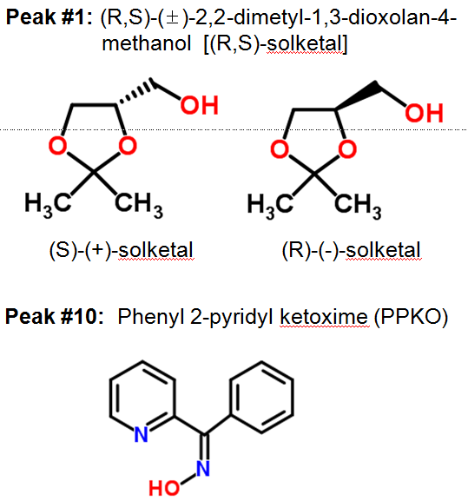
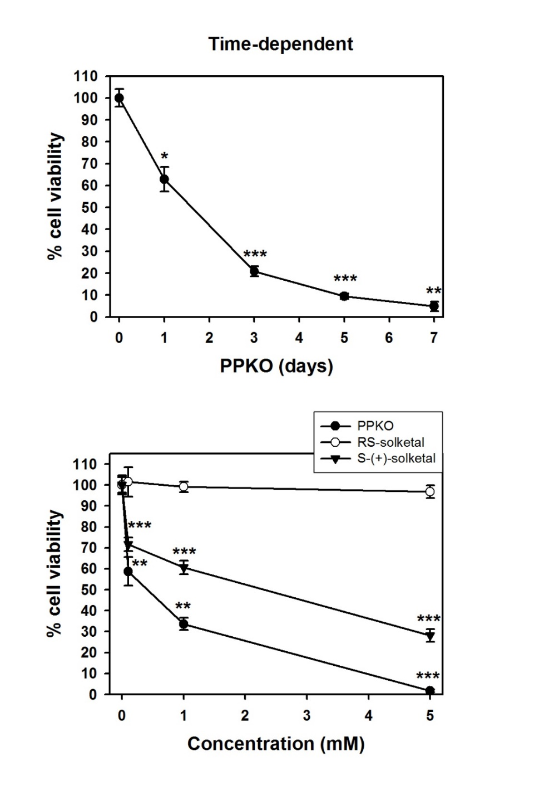
Phenyl 2-pyridyl ketoxime induces cellular senescence-like alterations
Aging Cell 2015, Dec 22

Slide 16
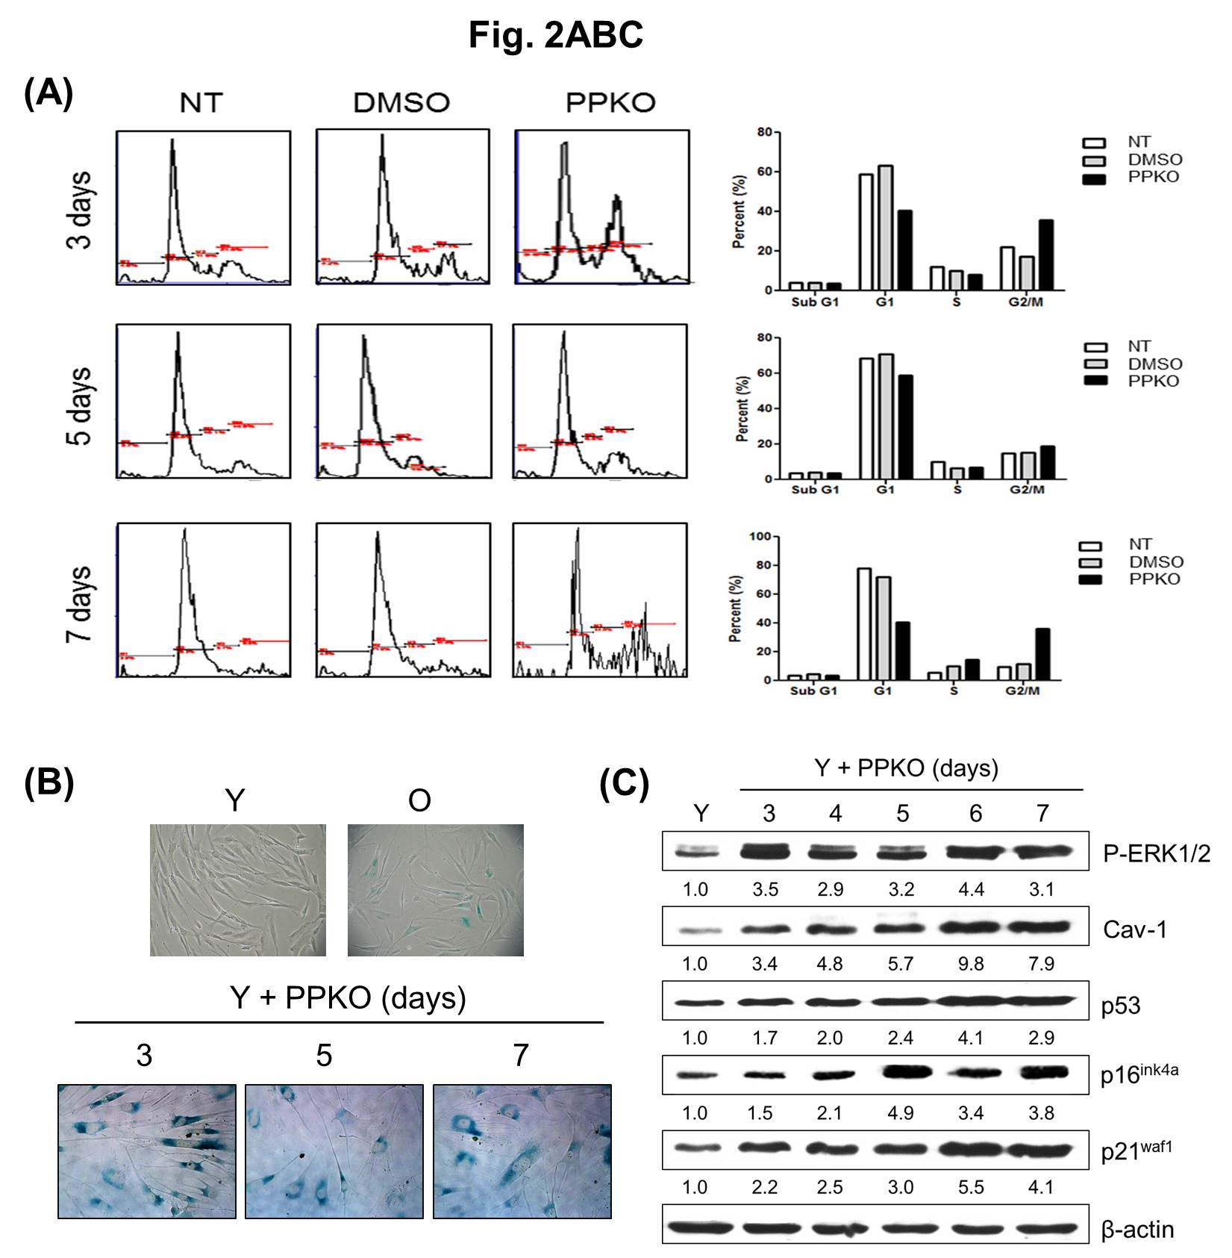
Phenyl 2-pyridyl ketoxime induces cellular senescence-like alterations

Slide 17
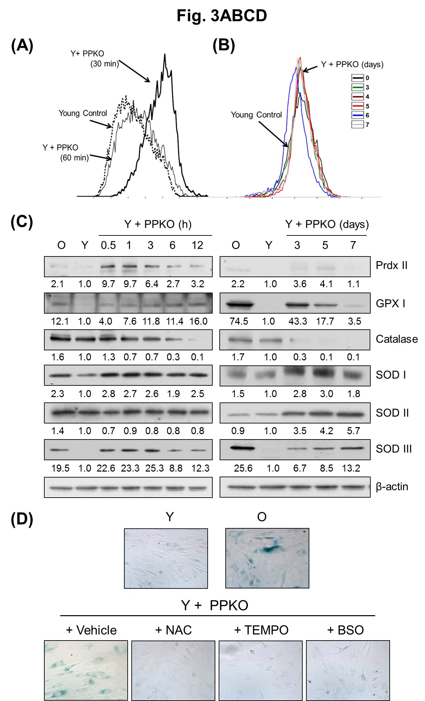
Phenyl 2-pyridyl ketoxime induces cellular senescence-like alterations

Slide 18
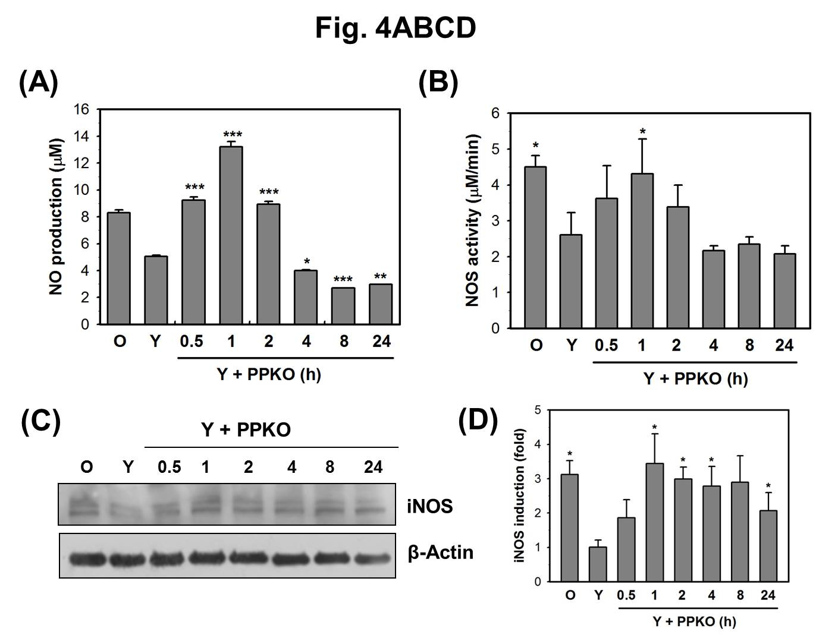
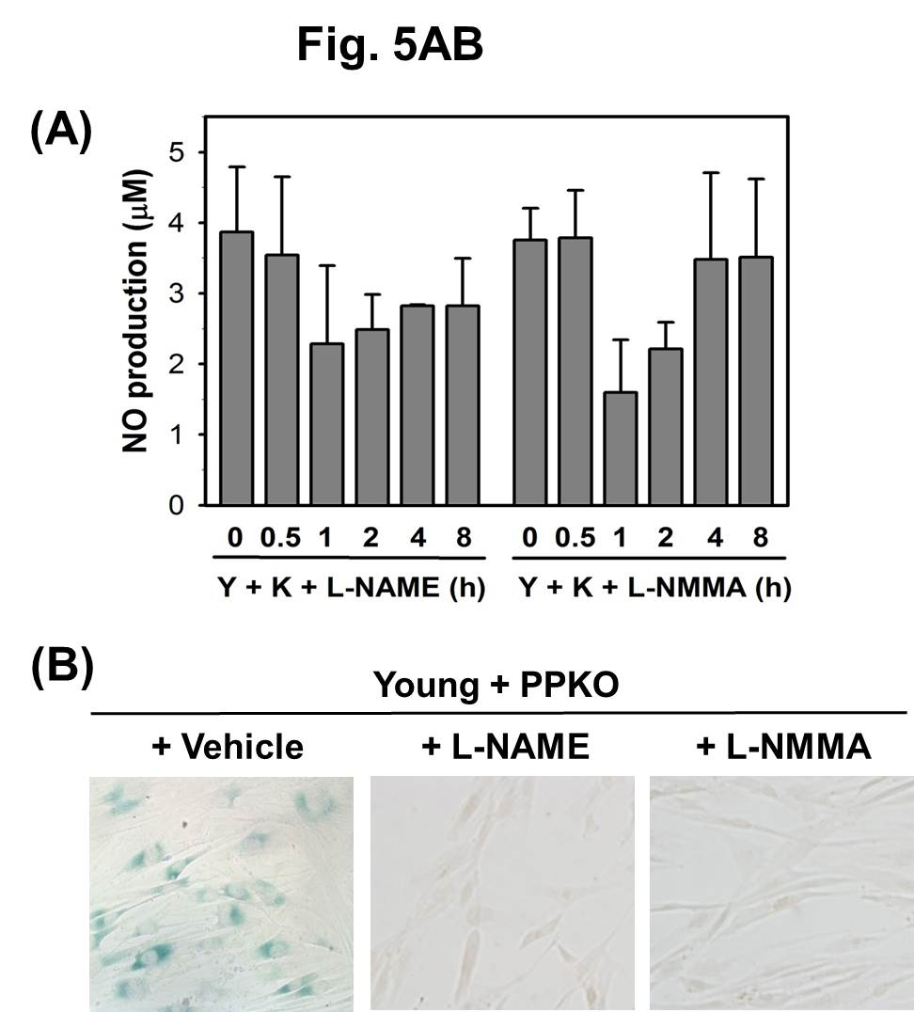
Phenyl 2-pyridyl ketoxime induces cellular senescence-like alterations

Slide 19
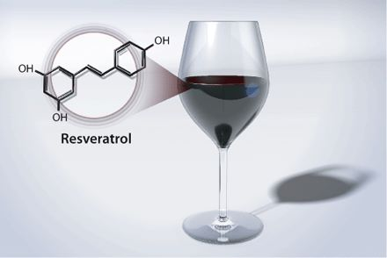
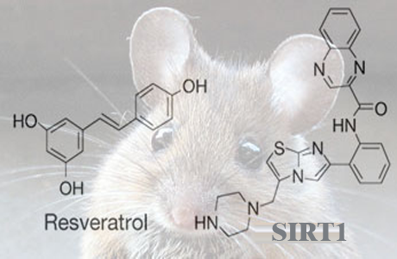
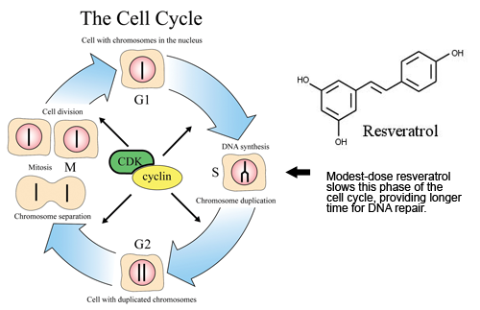
How would Expand Life Span and restore Senescence?
SIRT1 Activator Extend the Life Span ?
David Sinclair
NATURE |VOL 425 | 11, 2003
Cell 155 (7): 1624-1638. 2013

Slide 20
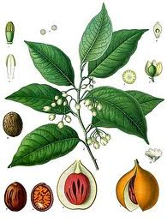
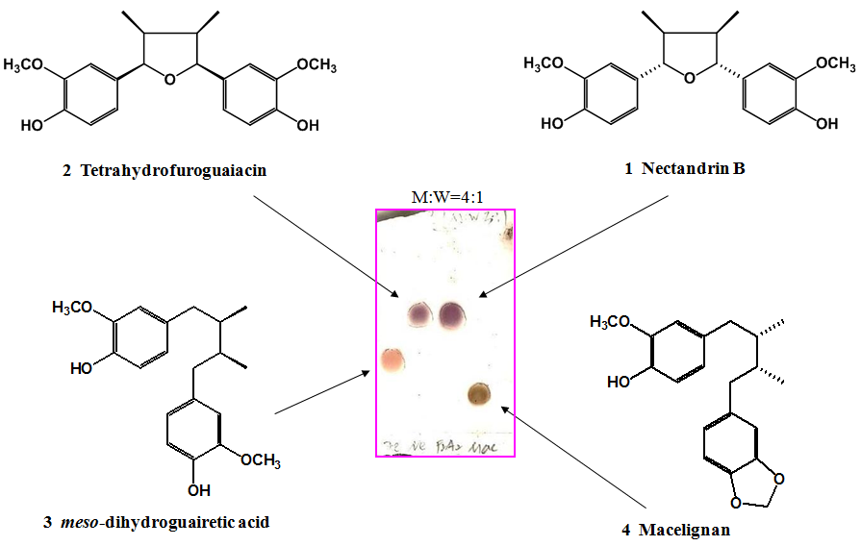
Potential AMPK activator Nec.B from Nutmeg

Slide 21
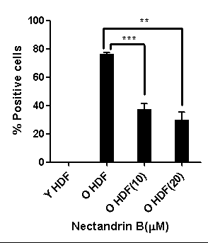
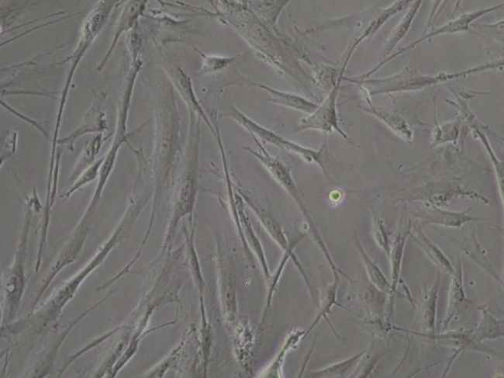
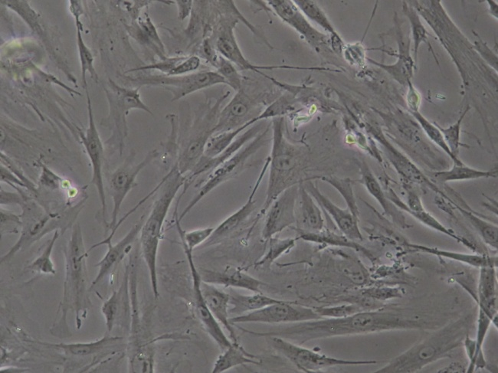
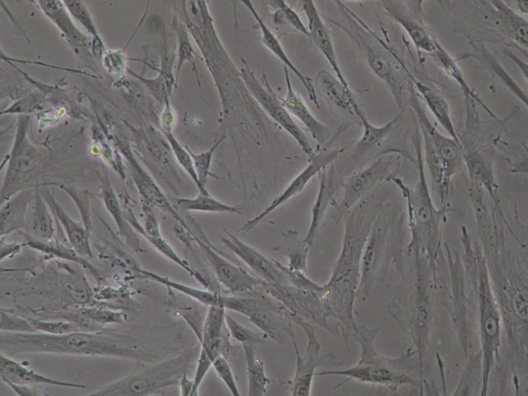
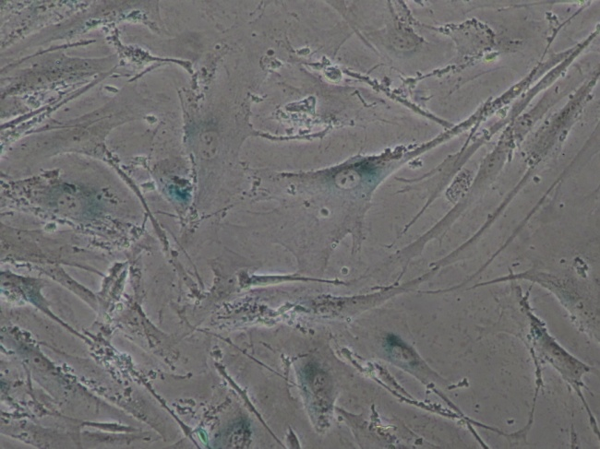
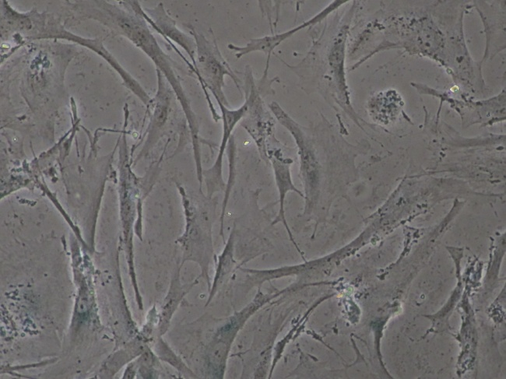
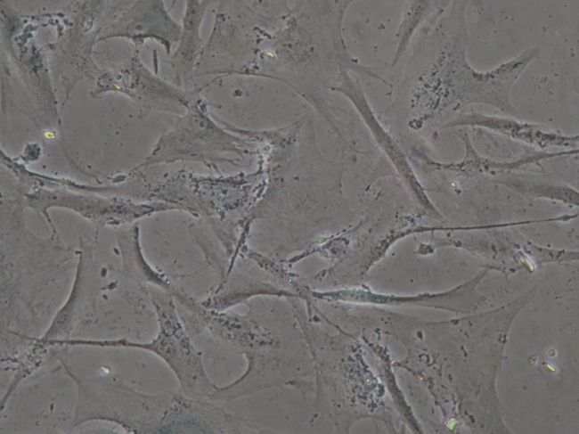
Nec.B treatment reduced SA-β–galactosidase staining in old HDFs
A
B
PEG Nec.B (10 mg/ml) Nec.B (20 mg/ml)
Young
Old
(mg/ml)
Fig. 2
Young (p11) and old (p37) HDFs were treated with either vehicle (PEG), or 10 or 20 mg/ml Nec. B for 48 h and stained with X-gal for the indication of SA-β–galactosidase activity. The stained cells were photographed by a microscope (100× magnification).
The percentage of SA-β–galactosidase-stained cells in A were calculated and plotted as the means±standard deviations.

Slide 22
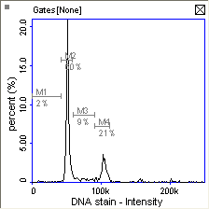
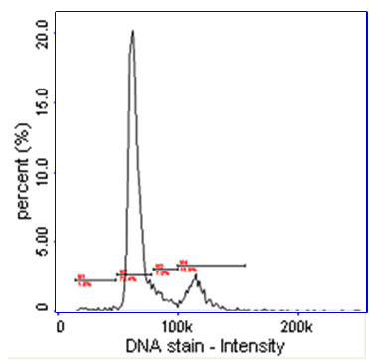
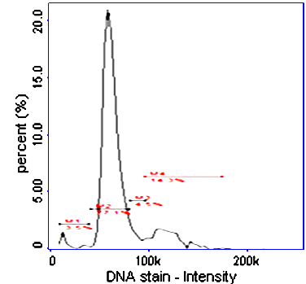
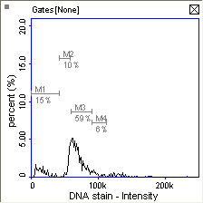
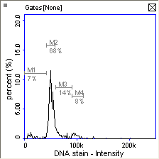
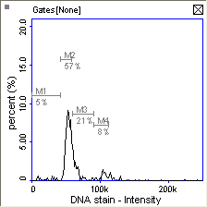
Flow cytometry for cell cycle analysis with DAPI staining
PEG NecB (10 mg/ml) NecB (20 mg/ml)
%gated
subG1 2
G0/G1 60
S 9
G2/M 21
%gated
subG1 2
G0/G1 74
S 7
G2/M 16
%gated
subG1 3
G0/G1 77
S 5
G2/M 14
Young
%gated
subG1 15
G0/G1 69
S 6
G2/M 5
%gated
subG1 7
G0/G1 68
S 14
G2/M 8
%gated
subG1 5
G0/G1 57
S 21
G2/M 8
Old

Slide 23
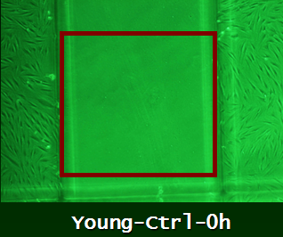
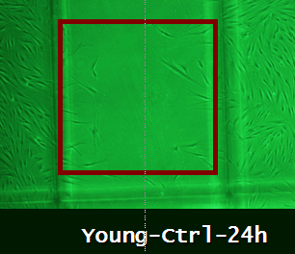
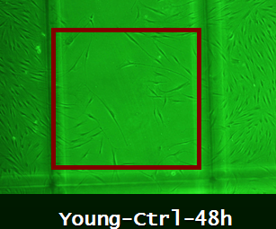
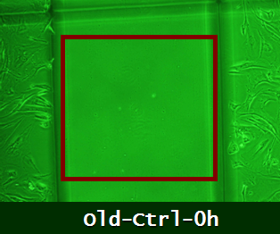
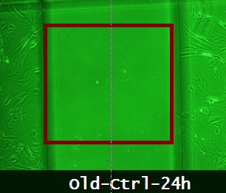
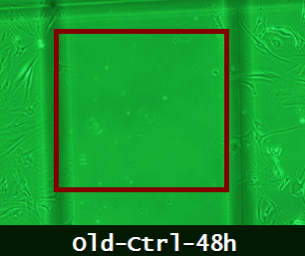






Migration effect by Nec.B in Senescent Cells
Control Young Senescent
Nec.B Young Senescent

Slide 24

Cellular Flow of Information

Slide 25



Workflow of Genomics : Microarray
Young cell senescent cell
48K
48K
48K
48K

Slide 26
Microarray Analysis
A
B

Slide 27
AMPK ( AMP-activated Protein Kinase
Phosphorylation site
ATP
Decrease energy
α
Increase energy
ATP
demand
β
supply
γ
ADP
ADP
AMPK(AMP-activated protein kinase)
Heterotrimer
α-subunits: catalytic site
β-subunits: glycogen-binding site
γ-subunits: AMP-binding site
Low Energy state → AMPK activation
AMPK Activity Is Sufficient to Induce Cell-Cycle Arrest
AMPK Requires p53 to Induce Cell-Cycle Arrest
(Craig B. Thompson et al., Molecular Cell, 2006)

Slide 28


AMP-activated protein kinase activators from Myristica fragrans(nutmeg) and their anti-obesity effect

Slide 29

Workflow of Proteomics

Slide 30





Proteomics based systemic analysis
Shotgun
proteomics
Data
analysis
Ingenuity
Pathway Analysis
FT-LTQ MS
Pathway
Studio
15
45
Related..
- Dystrophin
319
2193
Related..
- morphology
- Cell cycle
476
14 patterns
MASCOT (v. 2.4)

Slide 31


Proteome Dynamics by Functional Classification

Slide 32
Sub data. Nec.B 가 초파리 수명연장은 아니지만 median life span에는 영향을 미침 : well-being을 의미
Life span effect of Nec.B in Fruitfly
Survival (%)
Days

Slide 33




Wounding of Animal Back

Slide 34

Epithelialization after wounding visualized
by H & E staining
No Treat Nec.B 10 Nec.B 20

Slide 35

Wound healing visualized by PCNA staining
No Treat Nec.B 10 Nec.B 20

Slide 36


Nec.B effect in Aged mouse

Slide 37
Sub data. Nec.B 처리한 노화 mouse의 운동성 향상

Slide 38






Analysis of AMPK expression in Aged mouse
Y-PEG
O-PEG
O-NEC.B

Slide 39






Analysis of p-AMPK expression in Aged mouse
Y-PEG
O-PEG
O-NEC.B

Slide 40
Not all molecules provide equal information
Genomics,
Transcriptomics
Proteomics
Regulomics
Microarrays
RNA-seq
Microwesterns
LC-MS
Living Cell Arrays
RNA
proteins
active proteins
active TF
Degradation
RNA
proteins
Presence or abundance
Activity
Notes:
Do not use epigenitic modifications

Slide 41


Living Cell Array (LCA) measures TF activity
Measure activity not abundance, TF has to be localized in the nucleus and has to bind to DNA
Simultaneous dynamic real-time activity of multiple TFs in living cells (no cell lyse)
Long term experiments, during tissue formation time scales
3D environment that better mimic physiological conditions
Cost does not scale with time
Notes:
Having things to pop-up of them for advantages of the methods

Slide 42


LCA-TF
Deirdre Meldrum, 2007

Slide 43

Lentivirus System
3rd Generation Lentiviral Plasmids
The 3rd generation packaging system offers maximal biosafety but is more cumbersome to use, as it involves the transfection of four different plasmids in the producer cells.

Slide 44


TF Dual Reporter System

Slide 45





LCA method

Slide 46

Large-scale array to monitor TF signaling in parallel Nec.B treated 1 to 10 days

Slide 47

Large-scale array to monitor TF signaling in parallel Nec.B treated 1 to 10 days

Slide 48

Living Cell Array (LCA) Pipeline in R
Weiss, Peñalver Bernabé et al (in review)
Weiss, Peňalver Bernabé, et al. (in preparation)
ALCA
NLCA
3-level Boolean Model
Dynamic Networks
Bootstrapping
Permutation

Slide 49

LCA shows different TF dynamic profiles for NecB activation of senescent HDF cells
NT Y Control
Young
Old
Notes:
Reorganize by treatment change

Slide 50




Living Cell array

Slide 51
How does the LCA network look like?
Young Sensecent
Up-regulated
No change
Down-regulated
Prior knowledge
Inference methods
Both

Slide 52
NLCA reveals the most important dynamic hubs
Day 0
Day 1
Young Sensecent
Up-regulated
No change
Down-regulated
Prior knowledge
Inference methods
Both
Notes:
Keep the legend in all the slides

Slide 53
NLCA reveals the most important dynamic hubs
Day 1
Day 3
Young Sensecent
Up-regulated
No change
Down-regulated
Prior knowledge
Inference methods
Both

Slide 54
NLCA reveals the most important dynamic hubs
Day 3
Day 5
Young Sensecent
Up-regulated
No change
Down-regulated
Prior knowledge
Inference methods
Both

Slide 55
NLCA reveals the most important dynamic hubs
Day 5
Day 7
Young Sensecent
Up-regulated
No change
Down-regulated
E2F1 and YY1 are key reporter constructs in the re-wiring process according to the model
Prior knowledge
Inference methods
Both
Notes:
Put a text indicating the importance of E2F reporter in the celullar re-wiring

Slide 56
NLCA reveals the most important dynamic hubs
Day 7
Day 10
Young Sensecent
Up-regulated
No change
Down-regulated
Prior knowledge
Inference methods
Both

Slide 57
Different phenotypes, different dynamic networks
Nec.B activation in Senescent HDF
Day 0
Day 1
Day 3
Day 5
Day 7
Day 10
Nec.B activation in Young HDF
Notes:
Constitietly active TFs whiel EGF is a transient response
Note that E2F1 neither YY1 are active in the EGF treatment

Slide 58











The validation of YY1 expression
YY1 → Snail → AKT → AMPK^{S485} ; cell survival, migration
→ Bcl2/Bcl-xL : anti-apoptosis
A
B
C
Old Nec.B
Young Old
Young Old
Ctl 24 48 (h)
PEG PEG N10 N20
PEG PEG N10 N20
Snail
AMPK
Caveolin-1
Bcl-xL
p-AMPK(Thr172)
p-p53
Bcl2
p-AMPK(Ser485)
pSTAT3
p53
STAT3
β-actin
p21
β-actin
D
Cyclin D1
β-actin

Slide 59













The role of mTOR-p38 MAPK by Nec.B in Sensecent cell
Y O N10 N20
Y O N10 N20
P-Ser²⁴⁴⁸-mTOR
p-PI3K (p85 Tyr458)
mTOR
PI3K (p85)
P-Thr³⁸⁹-p70S6K
p-AKT
p70S6K
AKT
p-ASK1 (S83)
P-Thr^{37/46}-4E-BP1
p-ASK1 (Thr838)
4E-BP1
ASK1
Raptor
P-JNK
Rictor
JNK1
PKC-α
p-p38
Rac1
p38
β-actin
β-actin

Slide 60

Schematic model for the role for NecB in senescent HDFs

Slide 61
Summary
Nec.B, a novel potential AMPK inhibitor restores cellular senescence in senescent HDF
Various Omic data shows Nec.B treated senescent HDF induced cell cycle, migration
LCA are capable to measure cellular process activity in time scales.
Combination of prior knowledge, inference methods and optimization leads to high confidence dynamic networks that can predict the key dynamic cellular processes for an observed phenotype
Computational results have been experimentally validated, demonstrating that our platform can be a very valuable resource for the systems biology community to study developmental processes

Slide 62




Acknowledgement
NorthWestern Univ.
Prof. Lonnie D. Shea
Gachon Medical Univ.
Prof. Jeon HeeSook
Prof. Yeo Eui Ju
Seoul Nat’ Univ
Prof. Oh Won Kwen
Yunsei Univ
Prof. Park Junsoo
KBSI
MS. Jang Hyun JIn
MS. Cho Eun Bi
MS. Kang Seihe

Slide 63
Thank You For Attention

